Slide 1

Between-Groups ANOVA
Chapter 12

Slide 2
Quick Test Reminder
One person = Z score
One sample with population standard deviation = Z test
One sample no population standard deviation = single t-test
One sample test twice = paired samples t
Two samples = independent t

Slide 3
Quick Distributions Reminder
Z = Distribution of scores
Z = distribution of means (for samples)
t = distribution of means (for samples with estimated standard deviation)
t = distribution of differences between paired scores (for paired samples with estimated standard deviation)
t = distribution of differences between means (for two groups independent t)

Slide 4
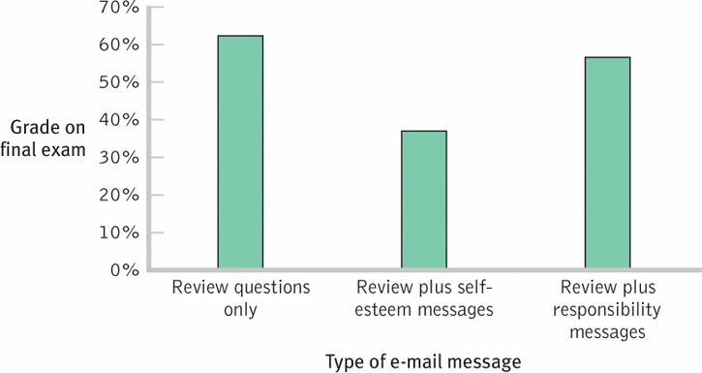

Slide 5
So what now?
We could do lots of pairwise t-tests
Group 1 versus Group 2
Group 1 versus Group 3
Group 2 versus Group 3
(that’s too easy though)

Slide 6
Why not use multiple t-tests?
The problem of too many t tests
Fishing for a finding
Problem of Type I error
New type 1 error rate = 1 – (1-alpha)^{c}
We want type 1 error rate to stay at .05

Slide 7
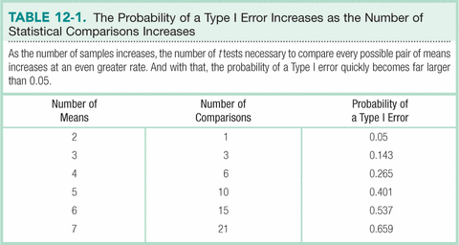

Slide 8
So what do we do?
When to use an F distribution
Working with more than two samples
ANOVA
Analysis of Variance
Used with two or more nominal independent variables and an interval dependent variable

Slide 9
Types of ANOVA
One-Way: hypothesis test including one nominal variable with more than two levels and a scale DV
Within-Groups: more than two samples, with the same participants; also called repeated-measures
Between-Groups: more than two samples, with different participants in each sample

Slide 10
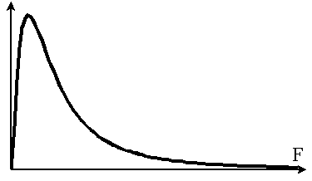
The F distribution

Slide 11
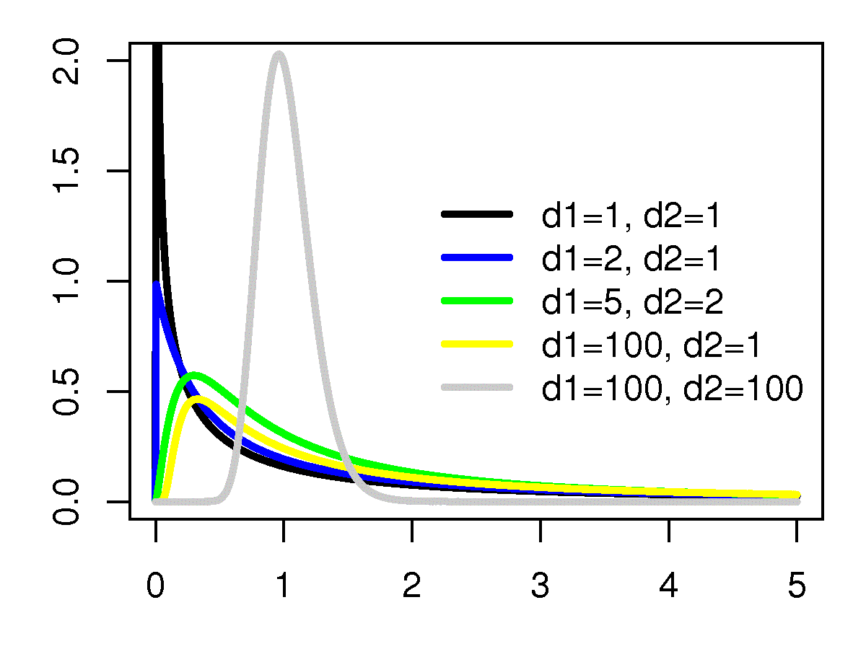
The F distribution

Slide 12
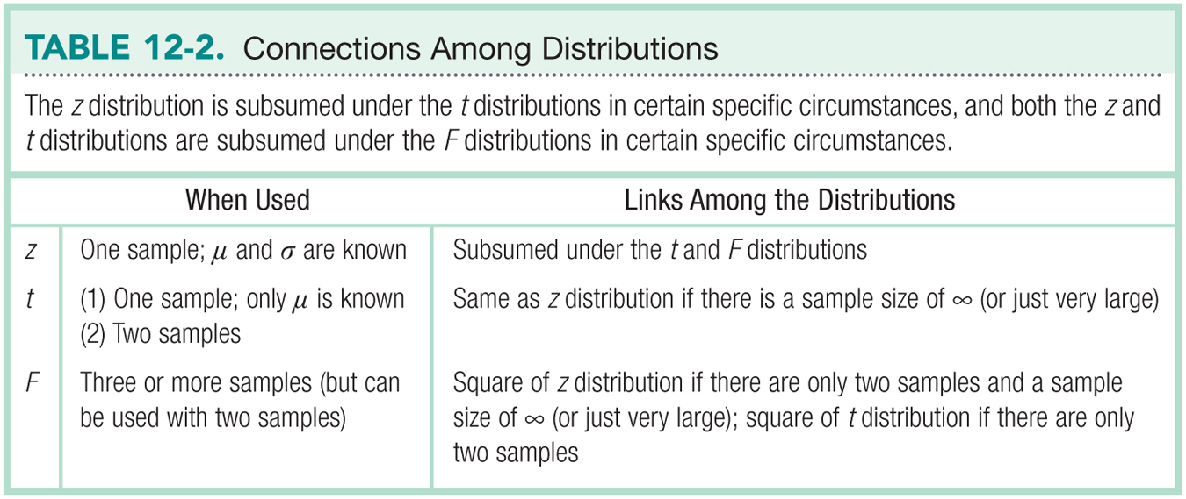

Slide 13
Let’s talk about test statistics
Test type | Formula
Z | M – μ_{M} σ_{M}
Single t | M – μ_{M} s_{M}
Paired t | M s_{M}
Independent t | M – M s_{difference}
Now what do we do with 3 or more Ms and SDs?

Slide 14
The F Distribution
Analyzing variability to compare means
F = variance between groups
variance within groups
That is, the difference among the sample means divided by the average of the sample variances

Slide 15
Logic behind the F Statistic
Quantifies overlap
Two ways to estimate population variance
Between-groups variability
Within-groups variability

Slide 16
Types of Variance
Between groups: estimate of the population variance based on differences among group means
Within groups: estimate of population variance based on differences within (3 or more) sample distributions

Slide 17
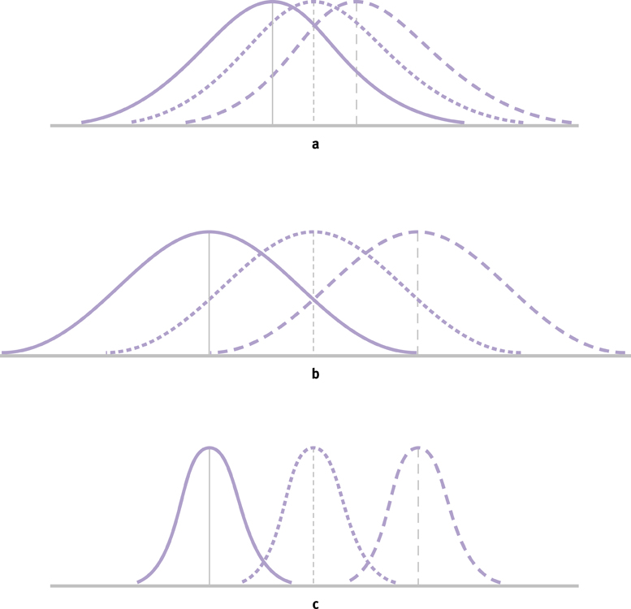
The Logic of ANOVA

Slide 18
Formulae

Slide 19
Let’s talk about df
Test type | df
Single sample | N – 1
Paired samples t | N – 1
Independent t | N – 1 + N – 1

Slide 20
Degrees of Freedom for ANOVA

Slide 21
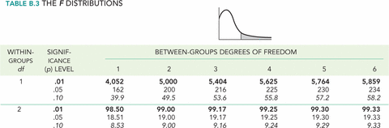
F table

Slide 22
F table
Down the side
DF denominator (N – 1 + N – 1 + …)
The big one
Across the top
DF numerator (Ngroups – 1)
The small one

Slide 23
The Source Table
Presents important calculations and final results in a consistent, easy-to-read format

Slide 24
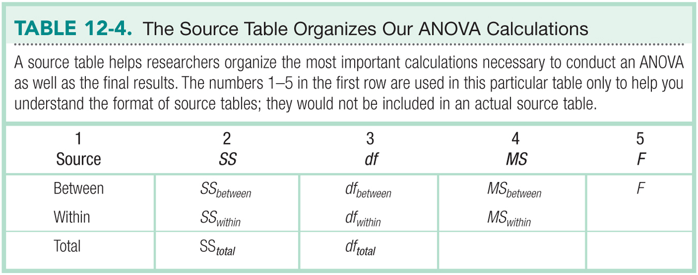

Slide 25
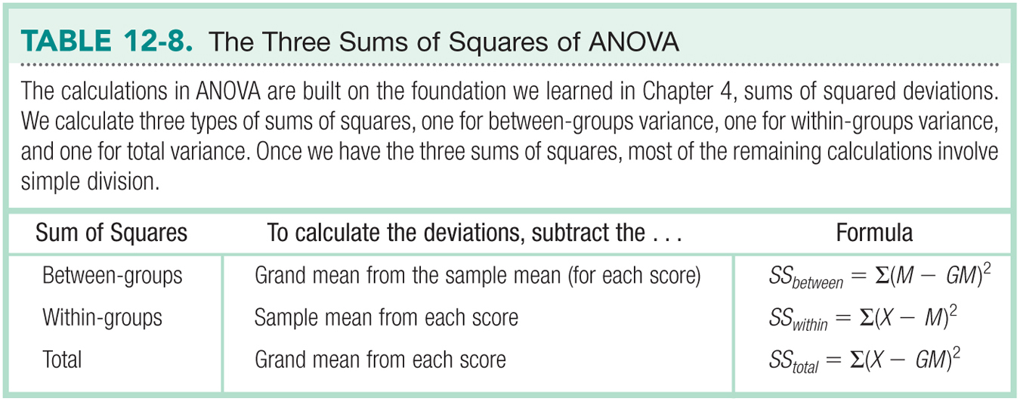

Slide 26
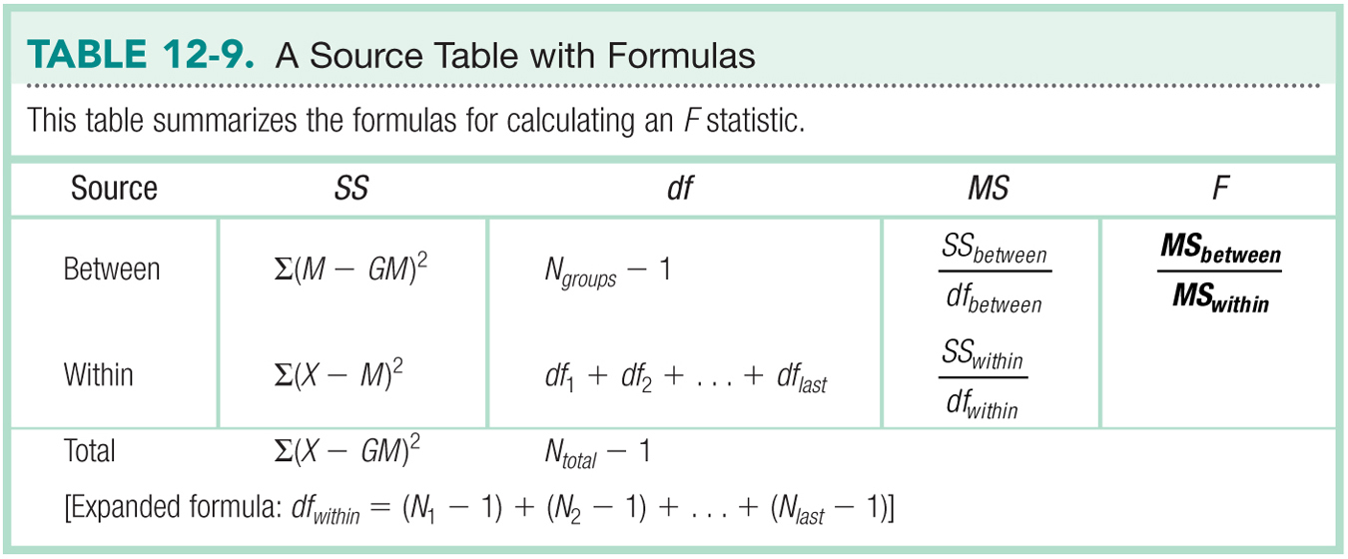

Slide 27
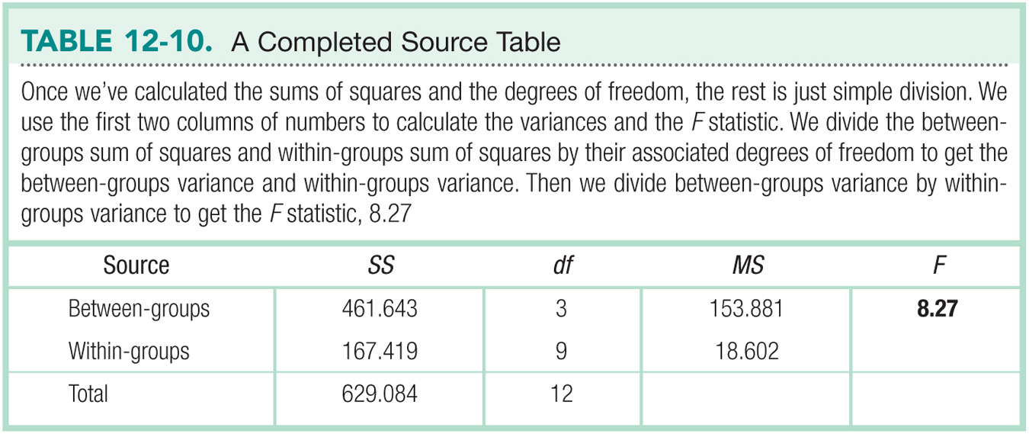

Slide 28
Assumptions of ANOVAs
Random selection of samples
Normally distributed sample
DV is scale
Homoscedasticity: samples come from populations with the same variance
Generally this is referred to as homogeneity

Slide 29
One-Way Between-Groups ANOVA
Everything about ANOVA but the calculations
1. Identify the populations, distribution, and assumptions.
2. State the null and research hypotheses.
3. Determine the characteristics of the comparison distribution.
4. Determine the critical value, or cutoff.
5. Calculate the test statistic.
6. Make a decision.

Slide 30
Bringing it All Together
What is the ANOVA telling us to do about the null hypothesis?
Do we reject or accept the null hypothesis?

Slide 31
Calculating Effect Size
R² is a common measure of effect size for ANOVAs.

Slide 32
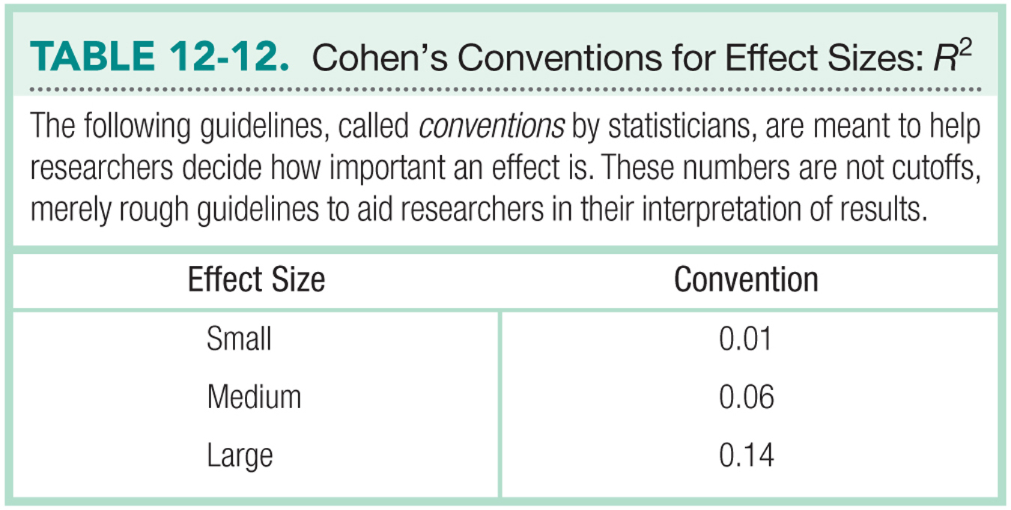

Slide 33
Post-Hoc Tests to Determine Which Groups Are Different
When you have three groups, and F is significant, how do you know where the difference(s) are?
Run a post hoc test
Run a post hoc correction
Tukey HSD
Bonferonni

Slide 34
Important Programming Note
Post hoc tests
Independent t because it matches the type of research design (between subjects ANOVA = between groups = independent t)
Post hoc corrections
Solve our type 1 error problem

Slide 35
Tukey HSD Test
Widely used post hoc test that uses means and standard error

Slide 36
The Bonferroni Test
A post-hoc test that provides a more strict critical value for every comparison of means.
We use a smaller critical region to make it more difficult to reject the null hypothesis.
Determine the number of comparisons we plan to make.
Divide the p level by the number of comparisons.

Slide 37
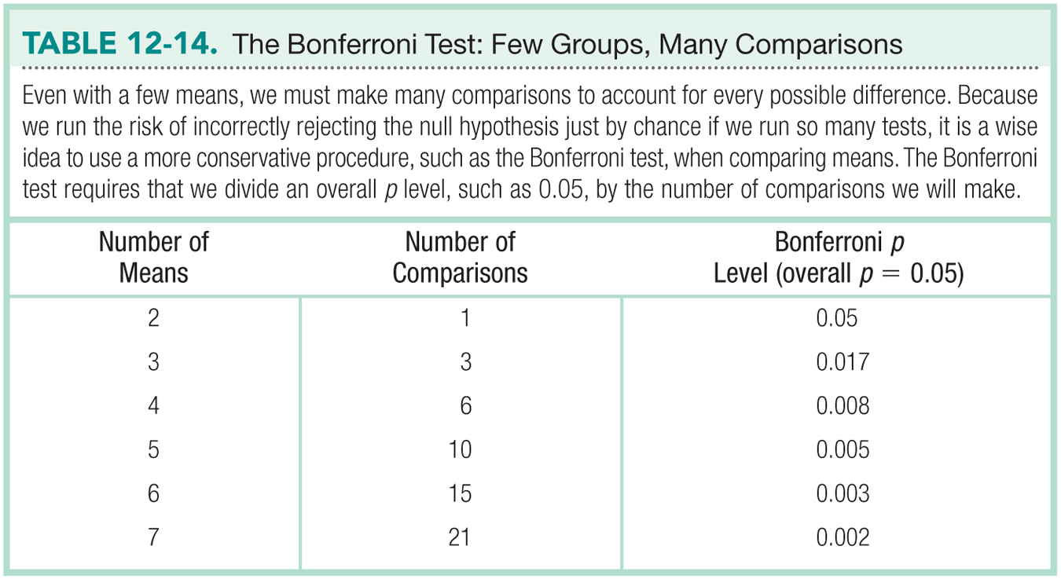

Slide 38
SPSS
Set up is the same as independent t
Group column with value labels
Dependent variable column

Slide 39
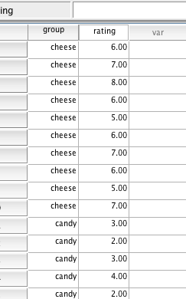
SPSS

Slide 40
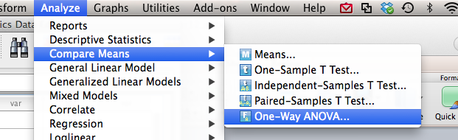
SPSS
Analyze > compare means > one way ANOVA

Slide 41
SPSS
Move dependent variable over into the dependent list
Move independent variable into the factor slot

Slide 42
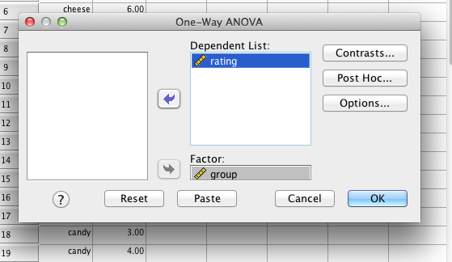
SPSS

Slide 43
SPSS
Click post hoc
Click your favorite option (we are going pick both to talk about them)
Normally you only pick one

Slide 44
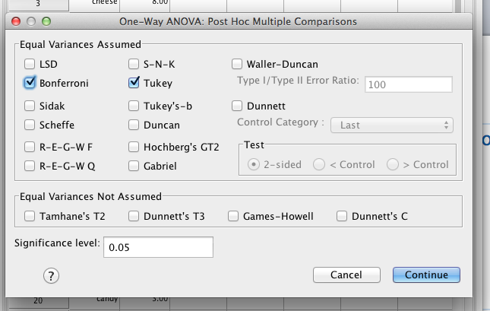
SPSS

Slide 45
SPSS
Click options
Pick descriptives so you get the mean, standard deviation of each group

Slide 46
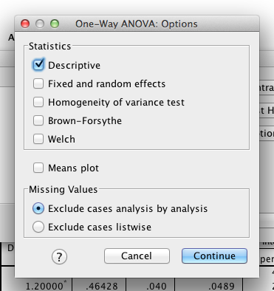
SPSS

Slide 47
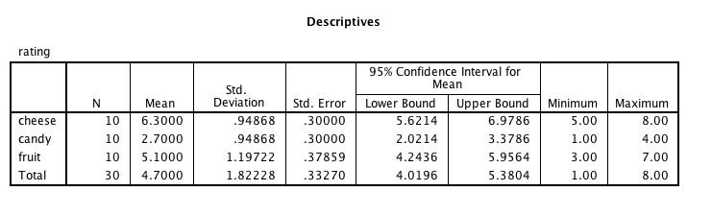
SPSS

Slide 48
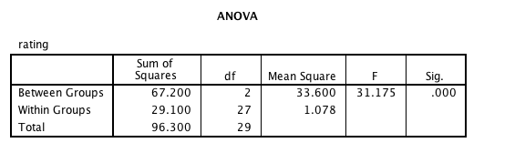
SPSS

Slide 49
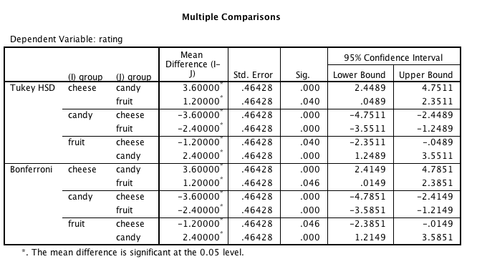
SPSS

